Slide 1
Classification Model I Support Vector Machines
Dr. Sugata Ghosal
CSIS Off-Campus Faculty
BITS Pilani

Slide 2
Session Content
Introduction
Support Vectors
Linear Support Vector Machine
Maximizing Margin
Handling non linearly separable data
Non-linear Classification
Kernel Functions
Midsem Tips

Slide 3
Support Vector Machines
Find a linear hyperplane (decision boundary) that will separate the data

Slide 4
Support Vector Machines
One Possible Solution

Slide 5
Support Vector Machines
Another possible solution

Slide 6
Support Vector Machines
Other possible solutions

Slide 7
Support Vector Machines
Which one is better? B1 or B2?
How do you define better?

Slide 8
Support Vector Machines
Find hyperplane maximizes the margin
=> B1 is better than B2

Slide 9
Support Vector Machines

Slide 10
Linear SVM
Linear Model
Learning the model is equivalent to determining the values of
How to find from training data?

Slide 11
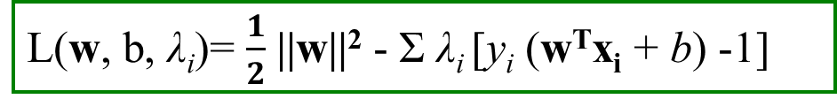
Learning Linear SVM
$$y_{i}(w•x_{i}+b)≥1, i=1,2,...,N$$
Objective is to maximize:
Which is equivalent to minimizing:
Subject to the following constraints:
or
This is a constrained optimization problem
Solve it using Lagrange multiplier method
Lagrange multipliers λ_{i} are 0 or +ve
L(w, b, λ_{i})= $\frac{1}{2}$ ||w||² - Σ λ_{i} [y_{i} (w^{T}x_{i} + b) -1]

Slide 12
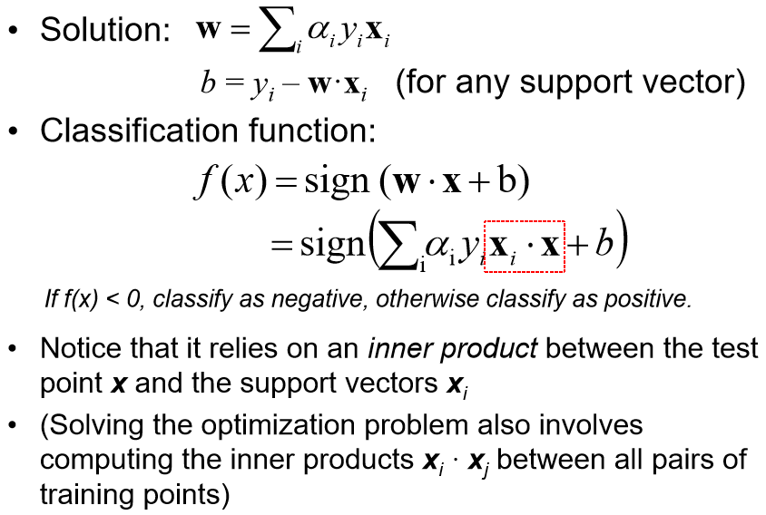
Learning Linear SVM
λ _{i}
λ_{i} is non-zero except for support vectors
λ _{i}

Slide 13
Example of Linear SVM
Support vectors

Slide 14
SVM Hyperplane – Visual Method

Slide 15
Learning Linear SVM
Decision boundary depends only on support vectors
If you have data set with same support vectors, decision boundary will not change
How to classify using SVM once w and b are found? Given a test record, x_{i}

Slide 16
Support Vector Machines
What if the problem is not linearly separable?

Slide 17
Support Vector Machines
What if the problem is not linearly separable?
Introduce slack variables
Need to minimize
subject to
If k is 1 or 2, this leads to similar objective function as linear SVM but with different constraints

Slide 18
Support Vector Machines
Find the hyperplane that optimizes both factors

Slide 19
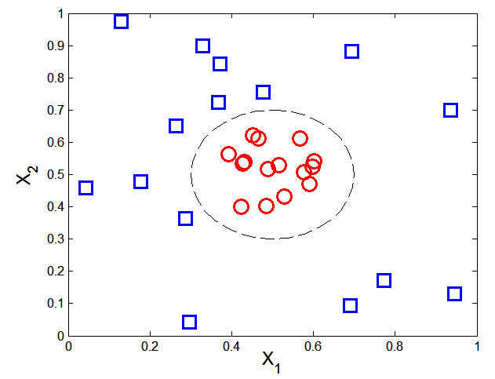
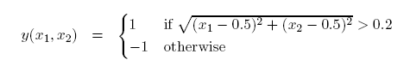
Nonlinear Support Vector Machines
Also applies to Logistic Regression Classifier Design
What if decision boundary is not linear?

Slide 20
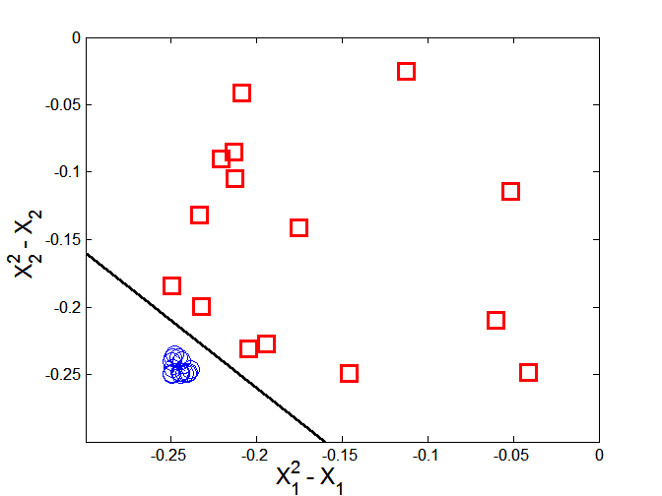
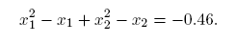
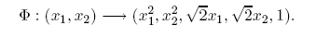
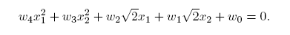
Nonlinear Support Vector Machines
Transform data into higher dimensional space
Decision boundary:

Slide 21
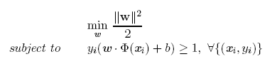
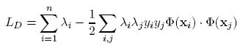
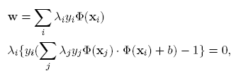
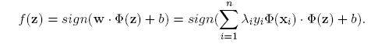
Learning Nonlinear SVM
Optimization Problem
which leads to the same set of equations (but involve Φ(x) instead of x)

Slide 22
Learning NonLinear SVM
Issues
What type of mapping function Φ should be used?
How to do the computation in high dimensional space?
Most computations involve dot product Φ(x_{i})• Φ(x_{j})
Curse of dimensionality?

Slide 23
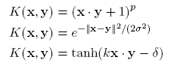
Learning Nonlinear SVM
Kernel Trick:
Φ(x_{i})• Φ(x_{j}) = K(x_{i}, x_{j})
K(x_{i}, x_{j}) is a kernel function (expressed in terms of the coordinates in the original space)
Examples:

Slide 24
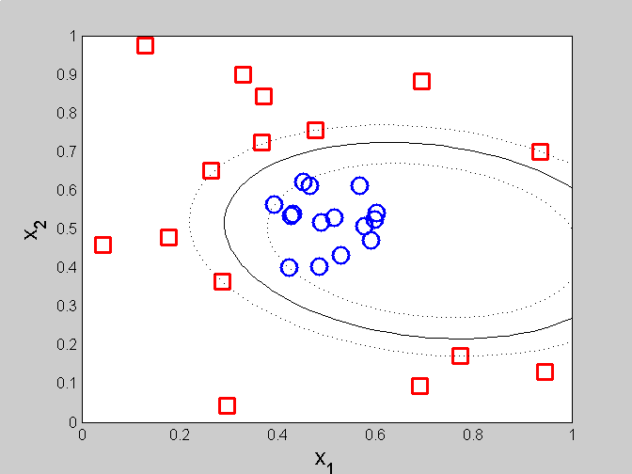
Example of Nonlinear SVM
SVM with polynomial degree 2 kernel

Slide 25
Learning Nonlinear SVM
Advantages of using kernel:
Don’t have to know the mapping function Φ
Computing dot product Φ(x_{i})• Φ(x_{j}) in the original space avoids curse of dimensionality
Not all functions can be kernels
Must make sure there is a corresponding Φ in some high-dimensional space
Mercer’s theorem (see textbook)

Slide 26
Summary
Robust to isolated noise points
Handle missing values by ignoring the instance during probability estimate calculations
Robust to irrelevant attributes
Redundant and correlated attributes will violate class conditional assumption

Slide 27
Thank You!
In our next session: Comparison and Applicability

Slide 28
Classification Model I Comparison and Applicability
Dr. Sugata Ghosal
CSIS Off-Campus Faculty
BITS Pilani

Slide 29
Session Content
Pros and Cons
Naïve Bayes Classifier
Logistic Regression
Support Vector Machines

Slide 30
Generative vs. Discriminative Classifiers
Training classifiers involves estimating f: X -> Y, or P(Y|X)
Generative classifiers like Naïve Bayes
Assume some functional form for probabilities P(X|Y), P(X)
Estimate parameters of P(X|Y), P(X) directly from training data
Use Bayes rule to calculate P(Y|X= x_{i})
Discriminative classifiers like Logistic regression, support vector machine
Assume some functional form for f: X -> Y
Estimate parameters of mapping function f directly from training data

Slide 31
Naïve Bayes Generative Model
Naïve Bayes classifier uses likelihood and prior probability to calculate conditional probability of the class
Likelihood is based on joint probability, which is the core principle of probabilistic generative model
Naïve Bayes simplifies the calculation of likelihood by the assumption of conditional independence among input parameters
Each parameter’s likelihood is determined using joint probability of the input parameter and the output label

Slide 32
Naïve Bayes – Advantages
Algorithm is simple to implement and fast
If conditional independence holds, it will converge quickly than other methods
Even in cases where conditional independence doesn’t hold, its results are quite acceptable
Needs less training data (due to conditional independence assumption)
Highly scalable, scales linearly with the number of predictors and training points
Can be used for both binary and multi-class classification problems
Handles continuous and discrete data
Not sensitive to irrelevant features
Doesn’t overfit the data due to small model size (compared to other algorithms like Random Forest)
Handles missing values well

Slide 33
Naïve Bayes – When to use
When the training data is small
When the features are conditionally independent (mostly)
When we have large number of features with minimal data set
Ex: Text classification

Slide 34
Naïve Bayes versus Logistic Regression
Naïve Bayes are Generative Models
Logistic Regression are Discriminative Models
When the training size reaches infinity, logistic regression performs better than the generative model Naive Bayes.

Slide 35
Logistic Regression and Gaussian Naïve Bayes Classifier
Interestingly, the parametric form of P(Y|X) used by Logistic Regression is precisely the form implied by the assumptions of a Gaussian Naive Bayes classiﬁer.
Therefore, we can view Logistic Regression as a closely related alternative to GNB, though the two can produce different results in many cases

Slide 36
Parameter estimation of generic logistic regression
Logistic Regression holds in many problem settings beyond the GNB problem
General method required for estimating it in a more broad range of cases.
In many cases we may suspect the GNB assumptions are not perfectly satisﬁed.
We may wish to estimate the wi parameters directly from the data

Slide 37
Characteristics of SVM
The learning problem is formulated as a convex optimization problem
Efficient algorithms are available to find the global minima
Many of the other methods use greedy approaches and find locally optimal solutions
High computational complexity for building the model
Robust to noise
Overfitting is handled by maximizing the margin of the decision boundary
In some sense, the best linear model for classification.
SVM can handle irrelevant and redundant data better than many other techniques
The user needs to provide the type of kernel function and cost function
Difficult to handle missing values
What about categorical variables?
Needs to be mapped to some metric space
Computationally expensive for large training data with many attributes

Slide 38
MidSem Tips
5 Questions, 30 Marks
Short answer type questions from Introduction, end-to-end machine learning projects
Loss calculation, parameter calculation based on linear regression based on direct method, gradient descent …
Naïve Bayes classification of discrete, continuous, text data. Possible application of smoothing
Logistic regression classifier design. Loss function. Weight update
SVM hyperplane calculation.

Slide 39
Visual Method for SVM Design in low dimensions
Visually identify the appropriate support vectors given the training data points
(0,2), (2,2) are support vectors for the blue class
(-1,-1) support vector for the red class.
Equation of the straight line passing thru’ blue support vectors
x2=2
Equation of the line parallel to x2=2 line and passing thru the red support vector
x2=-1
Equation of the maximum margin classifier is parallel line midway between x2=2 and x2=-1
x2=0.5
Margin will be 3.
Important:
Lines passing thru’ support vectors do not need to be horizontal or vertical
Support vectors need to be visually identified so that largest margin can be obtained.
x2
x2=2
(2,2)
(0,2)
x1
x2=-1
(-1,-1)

Slide 40
Linear Regression Calculation
What is the best fitting 2nd order polynomial for the training data shown?
y= a0+a1x+a2x^2
Determine the optimal values of a0, a1, a2 for the minimum sum of squared difference between predicted and target values (y)
Feature transformation; x1=x, x2=x^2
So, we have, predicted value
for x=0, a0+a1.0+a2.0
For x=1, a0+a1.1+a2.1
For x=2, a0+a1.2+a2.4=5
SSD Loss function: (a0-0)^2+(a0+a1+a2-1)^2+(a0+2a1+4a2-5)^2
Minimize this SSD loss
Differentiate the loss function w.r.t. a0, a1, a2 and equate to 0 and solve for a0, a1, a2
2a0+2(a0+a1+a2-1)+2(a0+2a1+4a2-5)=0
2(a0+a1+a2-1)+2(a0+2a1+4a2-5)2=0
2(a0+a1+a2-1)+2(a0+2a1+4a2-5)4=0
Solve for a0, a1 and a2 from the above 3 equations
You can also solve this problem using direct matrix inversion method. Both techniques will give the same result
x | y
0 | 0
1 | 1
2 | 5

Slide 41
Logistic Regression Classifier Design
Design an LR classifier to classify the training data shown with 100% accuracy
Note the data cannot be linearly separated.
Hence, feature transformation is needed.
Introduce feature transformation x1 = x^2.
Predicted LR output = 1/ (1+exp(-w0-w1x1))
Recall,
Predicted class label = +1 if predicted output >0.5
Predicted class label = -1 if predicted output <0.5
Hence, -w0-w1 >0 and –w0 < 0
Choose w0 and w1 to meet these conditions.
Note multiple choices of w0 and w1 will give right classification
Input x | Class label
-1 | 0
0 | 1
+1 | 0
Feature transformation
Input x1 | Class label
+1 | 0
0 | 1
+1 | 0

Slide 42
Thank You!
In our next session: Classification Model II

